Slide 1
Introduction To Embedded System

Slide 2
Embedded System
An embedded system is an electronic/electro-mechanical system designed to perform a specific function and is a combination of both hardware and firmware (software)
An embedded system is some combination of computer hardware and software, either fixed in capability or programmable, that is specifically designed for a particular function.

Slide 3
Embedded System
To perform a specific function
Combination of both h/w and s/w
May or may not contain an O.S
The firmware of the embedded system is pre-programmed and it is non alterable by the end user

Slide 4
Classification of ES
1. Based on generation
2. Based on Complexity
3. Based on deterministic behavior
4. Based on triggering
5.Based on performance and functional requirements

Slide 5
1. Classification Based On Generation
First generation : 8 bit µp like 8085- simple h/w – f/w in assembly code
ex: Digital telephone keypads, Stepper motor control units etc...
Second generation : 16 bit µp and 8/16 bit µc – instruction set much more complex & powerful
Some may contain OS
ex: Data acquisition systems, SCADA system(supervisory control and data acquisition is a type of industrial control system(ICS). Industrial control systems are computer-controlled systems that monitor and control industrial processes that exist in the physical world.) etc
Third generation : 32 bit µp and 16 bit µc – DSP and ASIC came to picture – pipelining evolved , may be embedded real time and general purpose OS
ex: Robotics, media, industrial process control, networking
Fourth generation : advent of SOC multi core processors- making use of high performance RTES, ex: smart phone devices, mobile internet devices etc...

Slide 6
2. Classification Based On Complexity
Small scale embedded system: Ex; electronic toy
Simple(built around low performance & low cost with 8/16 bit up/uc)
Not time critical
Low performance
Low cost
May or may not contain o.s
medium scale embedded system: ( 16/32 bit)
Slight complex in h/w and s/w
Medium performance
Low cost
Usually contain an embedded o.s
Large scale embedded system : (32/64 bit)
Highly complex h/w and s/w
Demanding high performance
May contain multi-core processors and co processors, reconfigurable soc
Usually contain RTOS for task scheduling and prioritization management
Ex. Decoding/encoding media, cryptographic etc....

Slide 7
3. Based on Deterministic Behavior
1.Hard Real time system
A real-time operating system should strictly adhere to the timing constraints for a task
The airbag control system and antilock braking system of vehicles are typical examples for hard real-time systems
2.Soft Real time system
Missing deadlines for tasks are acceptable for soft real-time systems, but the frequency of deadline missing should be within the compliance limit
ATM is a typical example of a soft real-time system

Slide 8
4. Based on triggering
The embedded systems are classified into two types based on the triggering of the systems:
time-triggered and event-triggered.
The system is triggered based on some activity like change in temperature or change in pressure, such system is said to be an event triggered embedded system.
If a system is activated or triggered based on the pre-defined task or preset time, then such system is said to be the time-triggered embedded system.

Slide 9
5.Based on performance and functional requirements
Standalone Embedded Systems
Real Time Embedded Systems
Networked Embedded Systems
Mobile Embedded Systems

Slide 10
Major Application Areas
Consumer electronics-camcorders, cameras etc
House hold appliances-television,dvd, washing m/c , oven....
Security systems-alarms, cameras, fire alarms....
Automotive industry-antilock breaking s/m, engine control, ignition s/ms, automatic navigation...
Telecom-cellular telephones, switches, handset...
Computer networking systems-printers, scanners, fax etc
Healthcare-EEG,ECG, scanner...
Measurement and instrumentation-DMM, CRO,s, logic analyzer
Banking & retail- ATM, currency counter...
Card readers-Barcode, smart card readers....

Slide 11
PURPOSE OF EMBEDDED SYSTEMS
Each embedded system is designed to serve the purpose of any one or a combination of the following tasks:
Data collection/storage/representation-data could be text, voice, image, video, electrical signals...(ADC/DAC)
Data communication-wireless n/w router, satellite, wired medium..
Data processing-speech coding, synthesis, audio video codec etc, digital hearing aid, medical applications.
Monitoring –medical domain-EEG,ECG, CRO, DMM, logic anylyzer.
Control- contains both sensors & actuators...
Application specific user interface- buttons, switches, keypads, lights, bells, displays, mobile phones....

Slide 12
ELEMENTS OF AN EMBEDDED SYSTEM
MEMORY
communication interface
System core
O/P PORTS (ACTUATORS)
I/O PORTS (SENSORS)
Other supporting IC s and subsystems

Slide 13
CORE OF THE EMBEDDED SYSTEM
The core of the embedded system falls in to any one of the following categories
1. general purpose and domain specific processors ( µp, µC, DSP )
2. ASIC(Application specific IC)
3. Programmable logic devices (PLD)
4. Commercial off-the-shelf components (COTS)

Slide 14
GPP vs. ASIP
General purpose processor :
Designed for general computational tasks
E.g.. Processor in the laptop
High volume production
Unit cost for a chip is low
ASIP instruction set and architecture optimized to specific application
ASIP arises when the GPP are unable to meet the application needs

Slide 15
Characteristics of an embedded system
Unlike general purpose computing system, embedded system posses certain specific characteristics and these are unique.
Application and domain specific: embedded systems are developed to do the intended functions only
They can not be used for any purpose
You can not replace an embedded control unit developed for a particular domain say telecom with another control unit designed to sey another domain like consumer electronics

Slide 16
Reactive and real time: emb.sys. are in constant interaction to the real world
Any changes happening in the real world (event)are captured by the sensors or i/p devices
The event may be periodic or unpredicted one(should not miss)
So emb.sys. are generally reactive
Timing behavior or the system should be deterministic
Should not miss deadlines

Slide 17
Operates in harsh environment: the environment in which the emb.sys. deployed may be a dusty one or high temperature zone
System placed in such areas should be capable to with stand all operating conditions
Distributed: emb.sys. may be a part of larger system
Automatic vending m/c contains card reader, vending unit etc.
They are independent but work together to achieve a common goal
Small size and weight: size, weight, shape etc will be one of the deciding factors to choose a product
Most applications demands small sized and low weight products
Power concerns: designed in such a way as to minimize the heat dissipation
May require cooling fan which occupies additional space
Even it’s a critical constraint battery operated systems, more the power consumption the less the battery life

Slide 18
Quality attributes of ES
QA are the non-functional requirements that need to be documented properly in any system design.
If the quality attributes are more concrete and measurable it will give a positive impact on the end product
Operational QA
Non-operational QA

Slide 19
Operational quality attributes
Attributes related to e.s when it is in the operational mode or online mode
Response: quickness of the system
How fast the system is tracking the changes in input variables
In flight control application any response delay in the system will create potential damages to the safety of the flight
Response time for a toy is not time critical
Throughput: efficiency of the system
Rate of production or operation of a defined process
Rates can be expressed in terms of units of products , batched produced, or any other meaningful measurements.
Generally measured in terms of benchmark (reference point)

Slide 20
Reliability: how much % you can rely upon the proper functioning of sys. Mean time between failure MTBF (frq of failure in hr/wk/mon) & mean time to repair MTTR ( how long the system is allowed to be out of order following a failure ) are the terms used in defining the system reliability

Slide 21
Maintainability: deals with the support and maintenance to the end user in the case of technical issues and failures or on the basis of a routine checkup
As reliability increases maintainability reduced
Two types (preventive or corrective maintenance)
User should replace the cartridge after n number of printouts (scheduled / periodic /preventive)
If paper feeding part of the printer fails required immediate repairs (maintenance to unexpected failure/ corrective)
Ideal value for availability is expressed
A = MTBF / (MTBF + MTTR)

Slide 22
Security : confidentiality( from unauthorized disclosure), integrity ( from unauthorized modification) , availability ( from unauthorized users)
Safety: deals with the possible damages that can happen to the operators or public
Eg. Due to breakdown or emission of radioactive

Slide 23
Non operational quality attributes
Attributes that needs to addressed for the product not on the basis of operational aspects
Testability: & debug ability: how easily one can test her design and by which mean she can test it.
h/w testing( peripherals and total h/w function) and firmware testing
Debugging the product as such for figuring out the probable sources that create unexpected behavior in the system
h/w level debugging ( issues created by h/w problems) and firmware debugging ( errors that appear as a result of flaws in the firmware)
Evolvability: related to biology.
Ease with which the embedded product can be modified to take advantage of new f/w or h/w technologies

Slide 24
Portability : measure of system independence
If the product is capable of functioning as such in various environments processors/controllers/os
Product can be ported to a new platform
Should be flexible and portable
Assembly language portability is poor

Slide 25
Time to prototype and market
Time to market: time elapsed between the conceptualization of a product and time at which the product is ready for selling
It’s a critical factor because embedded technology is one where rapid technology change is happening
Time to prototype: its an informal kind of rapid product development in which the important features of the product under consideration are developed
If prototype is developed faster, the actual development time can be brought down significantly.

Slide 26
Per unit cost and revenue : cost will be closely monitored by both end users
Proper market study should be carried out before deciding per unit cost
During design and development only investment no returns
Once the product is ready to sell and its introduced to the market – product introduction stage
In growth phase product grabs high market share
During maturity phase the growth and sales will be steady and revenue reaches at its peak
Product retirement/decline phase starts with the drop in sales volume, market share and revenue
At some point of decline stage the manufacturer announces discontinuing of the product
Unit cost is very high during the introductory stage

Slide 27
Classification and Development Skills Requirements for the Embedded Systems

Slide 28
Classification of ES
Small Scale Embedded Systems
Medium Scale Embedded Systems
Sophisticated Embedded Systems

Slide 29
Skills for ES
Skills for Small Scale System
Full understanding of a microcontroller with a basic knowledge of computer architecture, digital electronic design, software engineering, data communication, control engineering, motors and actuators, sensors and measurements, analog electronic design and IC design and manufacture

Slide 30
Cont………..
Median Scale Embedded Systems
'C'/C++/Java programming and RTOS programming and program modeling skills
Programming the Tasks or threads and their scheduling by RTOS.
Programming priorities and Cooperative and preemptive scheduling.
Use of Inter processor communication functions.
Use of shared data, and programming the critical sections and re-entrant functions.
Use of semaphores, mailboxes, queues, sockets and pipes.
Handling of interrupt-latencies and meeting task deadlines.
Use of various RTOS functions.
Use of physical and virtual device drivers.

Slide 31
Cont……………
Sophisticated Scale Embedded Systems
Team is needed to co-design and solve the high level complexities of the hardware and software design.
An embedded system hardware engineer should have full skills in hardware units and basic knowledge of 'C'/C++ and Java, RTOS and other programming tools.
Software engineer should have basic knowledge in hardware and a through knowledge of 'C', RTOS
and other programming tools. A final optimum design solution is then obtained by system integration.

Slide 32
Case Study:AUTOMATIC CHOCOLATE VENDING MACHINE (AVCM)

Slide 33
ACVM Specifications
Alphanumeric keypad on the top of
the machine.
A child interaction with it when
buying a chocolate.
Owner commands and interaction
with the machine.

Slide 34
Cont……….
Three line LCD display unit on the
top of the machine.
Displays menus, entered text,
pictograms, and welcome, thank and
other messages, and time and date.
Child as well as the ACVM owner
GUIs with the machine using keypad
and display.

Slide 35
Coin insertion and delivery slots, and Internet port
Coin insertion slot so that the child
can insert the coins to buy a chocolate
Delivery slot to collect the chocolate,
and coins if refunded
Internet connection port so that owner can interact with ACVM from remote

Slide 36
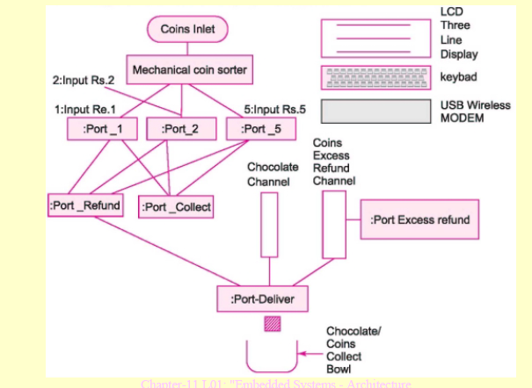
Basic system in ACVM

Slide 37
Reprogram of the codes and relocation of the codes
The system ROM or flash or EPROM whenever the following happens:
(i) the price of chocolate increases,
(ii) the message lines or menus or advertisement graphics needs to be changed or
(iii) machine features change.

Slide 38
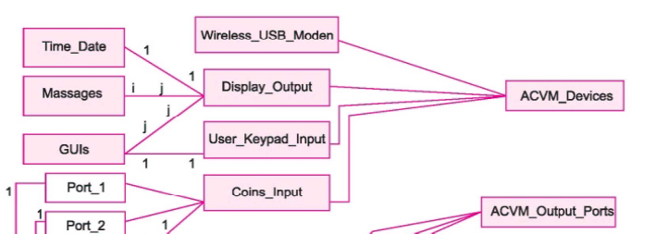
Class diagram for ACVM Part-1

Slide 39
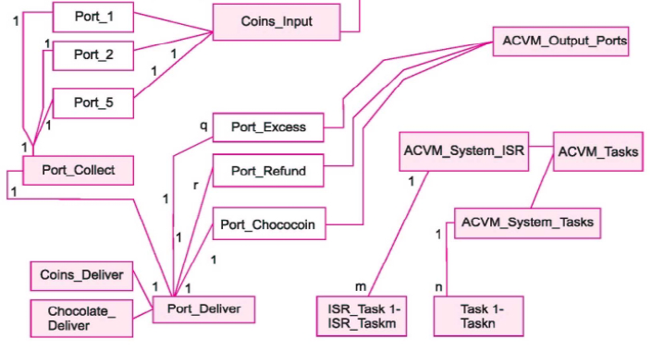
Class diagram for ACVM Part-2

Slide 40
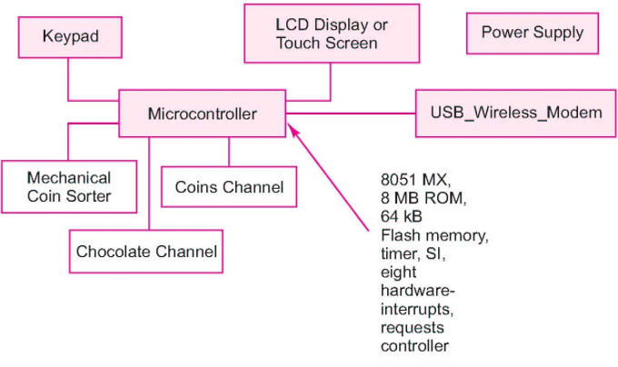
Block diagram of ACVM hardware including Microcontroller

Slide 41
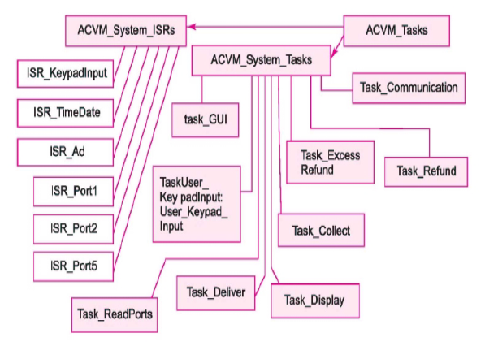
Software architecture (ISRs and Tasks) for ACVM

Slide 42
Case Study: Digital Camera

Slide 43
Specifications
Camera records the pictures using a chargecoupled devices (CCD) array.
The array consisting of large number of horizontal rows and vertical columns of
CCD cells for the picture
In each row of cells, a number of CCD cell
unexposed to the picture but used for off-set
corrections in the each-row output from the
picture cells.

Slide 44
Camera Picture resolution
2592 × 1944 pixels, there are 2592 ×
1944 = 5038848 set of cells.
Each set of pixel has three cells, for the
red, green and blue components in a pixel.
Each cell gets exposed to a picture
when shutter of camera opens on a user
command.

Slide 45
Controllers, LCD display, Switches and buttons
A set of controllers─ to control shutter, flash, auto focus and eye-ball image control.
LCD display for graphics and GUI
Switches and buttons for inputs at camera.
User gives commands for switching on the
camera, flash, shutter, adjust brightness,
contrast, color, save and transfer.
When a button for opening the shutter is
pressed, a flash lamp glows and a self-timer
circuit switches off the lamp automatically

Slide 46
Picture transfer Ports
JPEG file for a picture can be copied or
transferred to a memory stick using a
controller
Sony memory stick Micro (M2) size
15×12.5×1.2 mm, flash memory of 2 GB
and 160 Mbps data transfer rate.
A picture jpg can be copied to a computer
connected through USB port controller.

Slide 47
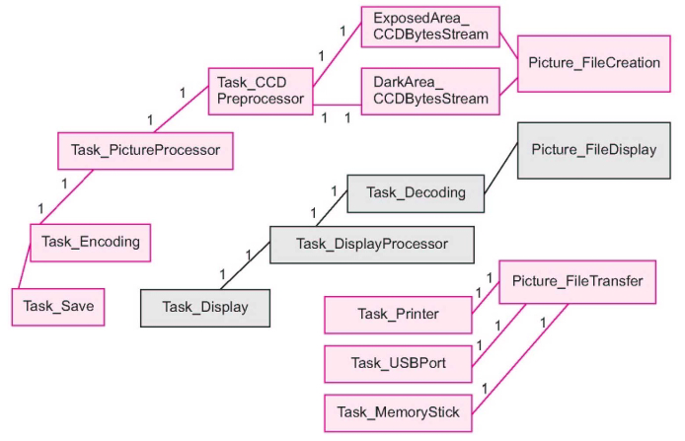
Class diagram

Slide 48
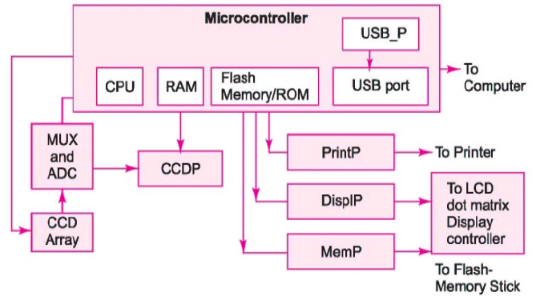
Digital camera hardware architecture

Slide 49
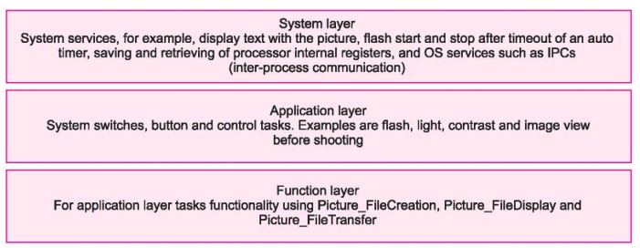
Software architecture upper layers

Slide 50
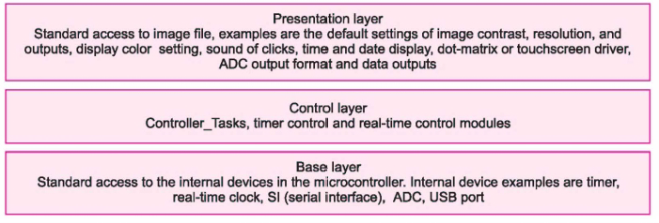
Software architecture lower layers

